Slide 1
Malaria Detection using Deep Learning and IBM cloud
Done By: Salem Barami

Slide 2
Introduction
Malaria is a disease transmitted by mosquitoes that generally causes high fever and chills, headache, vomiting and sometimes death. It is caused by protozoan parasites which live in the red blood cells of the human host. Symptoms often include night sweats, fevers above 101° Fahrenheit (39°C), shaking chills, and nonspecific symptoms such as malaise and fatigue. The average life expectancy after diagnosis is around one year with some patients surviving up to three years from initial diagnosis. In this project, CNN will be used to detect/predict a parasitized cell from an uninfected based on image of cells uploaded by the user.

Slide 3
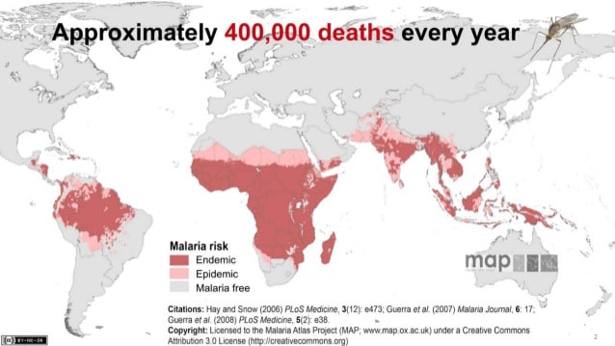

Slide 4
Solution
Deep Learning
Can recognize patterns in microscopic images with very high accuracy
Can be fully automated
Can eliminate the risk of confusion, error and mistakes

Slide 5
Why use DL for Malaria Detection?
Higher Accuracy than other traditional approaches
Takes less time
Cheaper

Slide 6
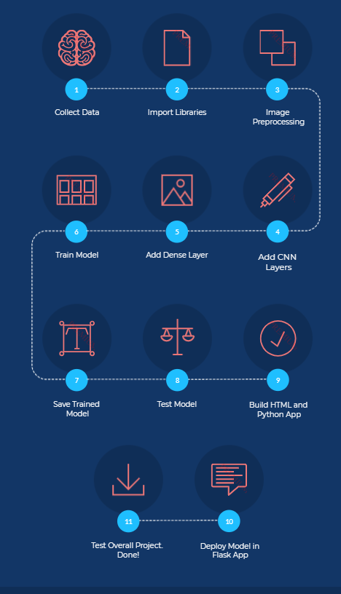

Slide 7
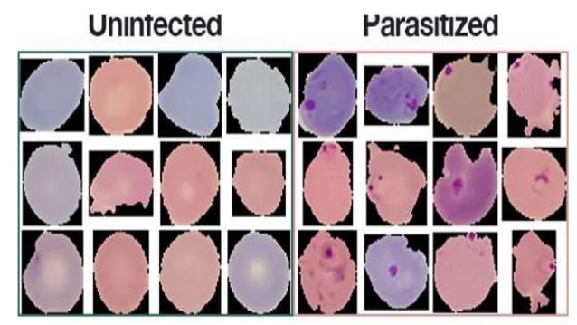

Slide 8
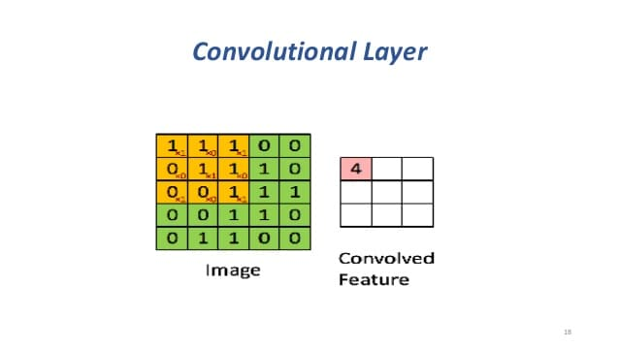

Slide 9


Slide 10

Project Demo

Slide 11
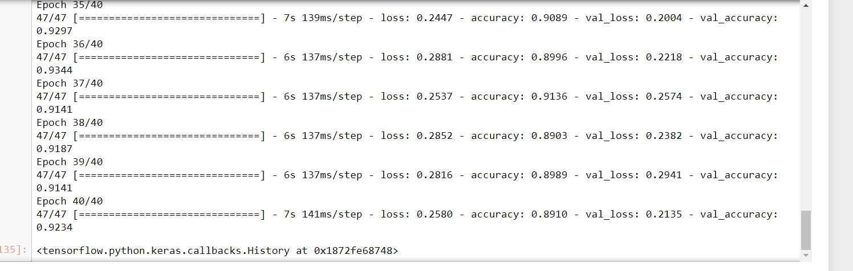

Slide 12
Conclusion
Finally, I was able to build a complete CNN model to detect malaria with an accuracy of 89.1% and validation accuracy of 92%. The model was successfully integrated in the flask app and the app is ready to be used.

